Slide 1
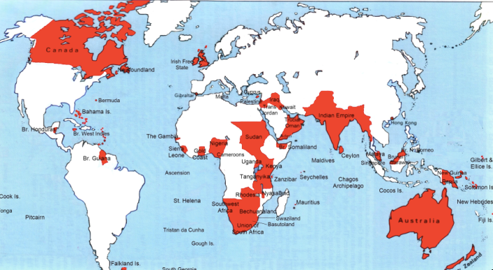

Lecture: 3.3.1. Empire & Underdevelopment
3:15 of audio in this slide; 11:15 in this slide group
Notes:
1870 saw the greatest empire the world has ever seen—the British Empire—approaching its peak. And this empire had both “formal” and “informal” aspects.
1945 saw the supersession of Britain by the United States as the leading industrial and commercial and imperial power. It sees the creation of an American empire that is definitely not “formal” but rather “informal”—but that is a story of the 1930s and thereafter, not of the years before 1914.
Europe—or, rather, Spain and Portugal—started building empires in the 1500s. It was not that they had unique technological or organizational powers to do so. What made the European empires different, however, was that they had interlocking rationales. They made political-military, ideological-religious, and economic sense. Spain’s conquistadores set out to serve the king, to spread the word of God, and to get rich.
Other adventurers and imperialists did not have this triple reinforcing dynamic. When the Portuguese arrived in what is now Malaysia in the 1500s, they met political-military opposition from local rulers, ideological-religious opposition from Islamic communities, and economic opposition from Chinese traders who did not want to be displaced.
But Chinese merchants had no political backing from Ming rulers, who regarded them as out-of-control.
Local sultans could not summon religious-ideological energy for crusades to expel the Portuguese from their bases.
And Islamic communities’ well-being was not profitable enough to far-away allies to generate sustained intervention.
For European adventurers, kings and guns, God and congregations, and money and trade reinforced one another. And so the European overseas empires of the 1500s and thereafter grew.
These early empires were, however, limited. Outside of the Americas, the sea became European but the land did not. Sea control, however, did mean a great deal. In the 1500s and 1600s control over the high-value low-weight luxury goods of East Asia, or over the precious metals of Latin America, made individuals’ fortunes, while also providing healthy boosts to early modern European royal treasuries, places for potentially disruptive young males, and ways for accompanying missionaries to believe they pleased their God. In the 1600s and 1700s the tobacco and slave trades plus the sugar-growing islands of the Caribbean boosted mercantile prosperity and government treasuries. West Indian empires become a focus of high politics, and a driver of then-slow economic growth. Plus the slave trade devastated Africa, and plausibly created the conditions that today keep Africa the poorest continent.

Slide 2
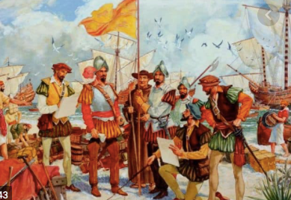
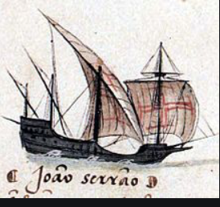
By 1810 the Tide of Empire Was Clearly Ebbing…
Little in the way of luxuries that could not be made more cheaply in the industrial core of the world economy:
Plus conquest was expensive
By contrast, trade was cheap
And maintaining hold on the conquests was even more expensive: the local notables whom governments usually relied on as intermediaries were the most likely to staff a pro-independence movement
Thus the odds were that it would be more expensive to conquer and then extract than to trade
Much of North America had already broken away from England over 1776-1783
The decade of the 1810s saw Latin America gain its independence as well…
1:15 of audio in this slide
Notes:
But come the 1800s the tide of empire appeared to be clearly ebbing. Conquest, unless the technology and organizational gradient is immense, is usually expensive. Trade, by contrast, is cheap. Moreover, people in distant countries and regions are happy to send you your stuff if you send them valuable stuff in the way of consumer goods. They are less happy if you try to conquer them and make them give you their stuff for free.
Moreover, maintaining hold on conquests was even more expensive: the local notables whom governments usually relied on as intermediaries were the most likely to staff a pro-independence movement
Thus the odds were that it would be more expensive to conquer and then extract than to trade. Much of North America had already broken away from England over 1776-1783. The decade of the 1810s saw Latin America gain its independence as well.
And that trend continued up until 1850 or so. Yes, Britain conquered India—but that was freakish good or bad luck. Yes, France conquered Algeria—but that took a large national effort for a place next door. France failed to conquer Mexico. By and large, Europeans ruled the seas and the coasts, but further? Difficult and costly. Until 1870 or so.

Slide 3
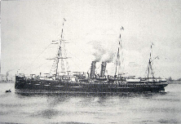
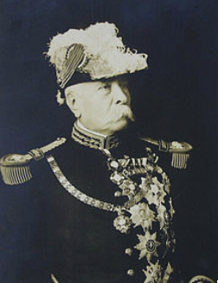
Yet After 1860 Empires Grew…
Industrialization made the power gradient immense:
“We have the Maxim gun, and they have not”
No place in which western Europeans could not impose their will by armed force:
Proconsuls were rarely focused on resource flows
Whether it might not be cheaper in the long run to simply trade
Omdurman in Sudan in 1898
10,000 soldiers of the Mahdist Sudanese regime died.
Only 48 British and Egyptian soldiers died
2:00 of audio in this slide
Notes:
Yet after 1860 empires grew.
The power gradient—technological, organizational, political—had become immense.
The improvements in transport and communications made war and conquest and occupation vastly easier. There was no part of the world in which western Europeans could not—if they wished—impose their will by armed force at moderate cost. And proconsuls were rarely focused on just what resources would flow back to the imperial metropolis from this extension of empire, and whether it might not be cheaper in the long run to simply trade and pay for them.
At the battle of Omdurman in the Sudan in 1898, 10,000 soldiers of the Mahdist Sudanese regime died. Only 48 British and Egyptian soldiers died. The difference was not entirely due to superior European military technology. The Mahdist regime did have proto-machine-guns, telegraphs, and mines—all bought from European suppliers. What it did not have was the organizational capacity and discipline to make effective use of them.
The outcome all across the globe was integration into the European dominated world economy, political submission—either formal or informal—to rule by European proconsuls, and the spread of European languages and European views of life around the globe. Missionaries brought European religions. Proconsuls interested in uplift brought European-style schools. Europe-originated culture, methods of administration, science, and technology began to percolate down. Members of future peripheral elites were taught as part of a civilizing mission—in French—how “our ancestors the Gauls” had fought the Romans in the first century B.C. Harbors, railroads, factories, and plantations sprung up from Bali in what is now Indonesia to Accra in what is now Ghana.
And everywhere peoples were taught that they were dirt under the feet of their European rulers.

Slide 4
Divergent Experiences
Arthur Lewis:
“The imperialists tell us… good government. The anti-imperialists argue… that empire… outlived its time… was irrelevant to development… held back development… de-developed…. Colonies were governed very differently…. One could nominate at least one country to fit each of these categories, from best to worst...”
The anti-colonialists seem to me to have the better of the argument
Did imperial powers follow growth-promoting policies in the colonies? By and large not.
Plus there were abattoirs like the Belgian Congo:
Listen to the sound of Leopold’s ghost/Yelling in hell for his hand-maimed host…
1:30 of audio in this slide
Notes:
Still, very different things were happening in different corners of the world: the only constant of formal empire was that there was nothing constant. As Arthur Lewis put it in his Growth and Fluctuations, 1870-1913:
>The imperialists tell us… good government. The anti-imperialists argue… that empire… outlived its time… was irrelevant to development… held back development… de-developed….
>Colonies were governed very differently…. One could nominate at least one country to fit each of these categories, from best to worst...
But by and large the anti-colonialists seem to me to have the better of the argument. Successful and rapid economic development in the nineteenth century required a government to build railroads, ports, and urban infrastructure; a government to establish schools; a government to create a legal framework for banking, and then for banks to pool the savings of the people and distribute them to what were for the time large-scale capital-hungry enterprises. And it required tariffs to keep nascent and infant industrial sectors from being squashed by foreign factory imports, and so provide room for businesses and engineers to learn how to run factories by doing, and so for communities of engineering expertise to develop and grow.
Colonial governments were somewhat interested in ports. But they were rarely if ever interested in the rest. Independent governments might well not find themselves following growth-promoting industrial polices. But they had a chance of doing so.
Plus there were abattoirs like the Belgian Congo, with King Leopold’s ghost yelling in hell for his hand-maimed host.

Slide 5
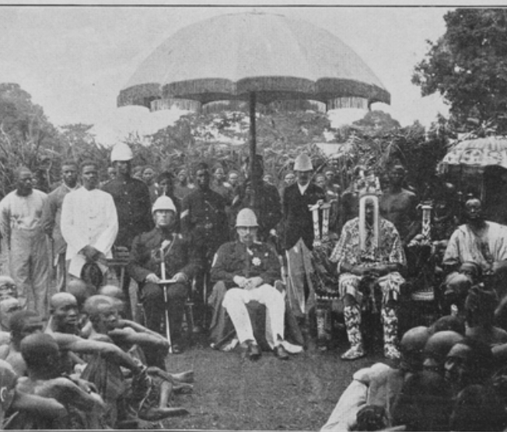
The Colonized Experience
The standard package for successful development;
Market-promoting government;
Building railroads, canals and ports;
Chartering banks for commerce and investment;
Establishing mass education
Imposing smart tariffs on those manufactured imports that would in the short-run crowd out production and thus the creation of the communities of engineering practice
Colonial masters would not allow the standard package
Neverthless, progress:
Even outside of the global north the world was far richer in 1950 than it had been in 1800
The center-of-gravity of what now is the global south was at a living standard of $2 a day in 1800s
$2.25 by 1870
$3.50 by 1913.
But still about $3.50 by 1950.
However, there were a number of economies that seemed to be taking advantage of opportunities:
Japan
Those parts of Latin America that escaped internal colonization by landed and bureaucratic elites
But the gap between global north and global south had grown: from 2.5 to 1 in 1800 to 4 to 1 in 1870 and 1913, and to 7 to 1 by 1950.
3:15 of audio in this slide
Notes:
Stable market-promoting government; building railroads, canals and ports; chartering banks for commerce and investment; establishing mass education; and imposing tariffs on those manufactured imports that would in the short-run crowd out production and thus the creation of the communities of engineering practice in those modern industries in which long-run comparative advantage lay—those were what Robert Allen and others have judged to have been the essentials for stepping on to the escalator of prosperity that was post-1970 modern economic growth.
But for the colonized in Asia and Africa before World War II that was not a possibility: they could not do that. Their colonial masters had little interest in and provided no support for such policies. And the competition that their natural resource products and their workers faced from the products and workers or extremely low-wage India and China crippled the wealth of a middle class that might otherwise have provided demand to spur industry, and made globalization more the foe than the friend of economic development.
How about Latin America, which had achieved independence from Spain and Portugal early in the 1800s? How did they do before World War II? Mexico, Columbia, Peru, Brazil, and the others suffered, by and large, from what one might call internal colonialists: a landed elite privileged by property ownership and Iberian descent that feared an educated proletariat, loved foreign-made manufactures, and had Iberian-derived legal systems that did not mesh well with the needs of commerce and industry.
Do not get me wrong: outside of the global north the world was far richer in 1950 than it had been in 1800, and richer by a substantial margin. If the center-of-gravity of what now is the global south was at a living standard of $2 a day in 1800s and $2.25 by 1870, it was about $3.50 by 1913. But, dragged down by China in war and revolution and by an India that had been heavily hit by the disruptions of trade that came with the Great Depression and then war, it was still about $3.50 by 1950. But there were a number of economies that seemed to be taking advantage of opportunities: Japan had already joined the industrial powers. Those parts of Latin America that escaped internal colonization by landed and bureaucratic elites were looked to be catching up: Chile, Argentina, Uruguay, and southern Brazil still looked more like a cross between an Australia and an Italy than like the externally or internally colonized. Venezuela had its oil boom. Cuba and Costa Rica showed signs of escape. Iran, Iraq, Lebanon, Egypt, Morocco, and Algeria; South Africa, Kenya, Zambia, Ghana, and Nigeria; Mexico and Peru all formed a global middle stratum.
But the gap between global north and global south had grown: from 2.5 to 1 in 1800 to 4 to 1 in 1870 and 1913, and to 7 to 1 by 1950.

Slide 6
Lecture: 3.3.2. The Scramble
0:15 of audio in this slide; 18:45 in this slide group
Notes:
Let’s look at a few small pieces of the scramble that turned the entire world—except for China (sorta) & Tibet, Japan, Thailand, & Ethiopia—into either European-ruled or European settler-ruled territory by 1914.

Slide 7
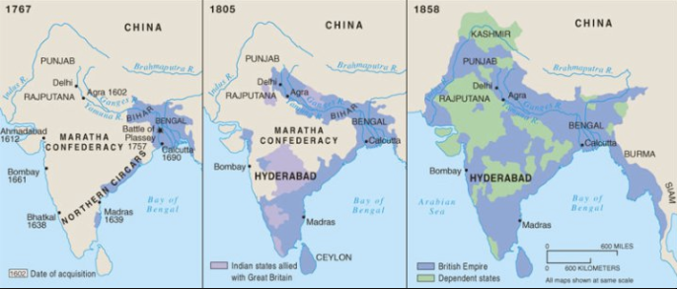
The Conquest of India
1767: Bombay, Madras, Calcutta, and tax collector for the collapsing Mogul Empire in Bengal and Oudh
1805: armies composed 3/4 of soldiers born in India; Viceroy Richard Wellesley’s conquest policy
1858: conquest complete with suppression of Sipahi Uprising
2:30 of audio in this slide
Notes:
In early 1756 the newly-installed Nawab of Bengal, Mîrza Mohammad Siraj ud-Dowla, wished to show the British in Calcutta who was master of Bengal. He borrowed some gunners and artillery pieces from the French and attacked and captured Calcutta and its Ft. St. William. He expected negotiations, and that the subsequent peace would see gratitude toward him on behalf of the French, much higher taxes paid him by trading Europeans, and much less tax evasion via smuggling by British who understood their place.
Big mistake.
The British sent 3,000 soldiers—800 British, 2200 Indian—north by sea from Madras to Calcutta. Siraj ud-Dowla mobilized for the battle. British commander Robert Clive bribed the Nawab’s three subordinates. The British East India Company acquired the taste for conquering, ruling, and taxing India, rather than merely trading with it.
By 1765 the British East India Company had successfully petitioned the Moghul Emperor in Delhi to be his tax collector for Bengal and Bihar.
By 1772 Calcutta was the capital of British India. Warren Hastings was its first Governor-General. The British East India Company had entered the sweepstakes in the succession wars over the territories of the Mogul empire.
The conquests which British-trained Indian-recruited armies that made the British the dominant power in India in the eighteenth century were carried out on a shoestring. Yet they soon became mopping-up operations: small wars against Indian powers that had no chance of assembling the resources to match the British-controlled forces in India. Each generation saw formerly independent principalities become subservient allies. Each generation saw former allies become puppets. And each generation saw former puppets become territories ruled by London. Nearly a century after Clive and Siraj ud-Dowla came the great the 1857 Sepoy Mutiny/Indian Mutiny/Sipahi Rebellion/Great Rebellion of 1857. It was defeated. And on May 1, 1876, the British government proclaimed Queen Victoria I Hanover to be Kaiser-i-Hind: Empress of India.

Slide 8
Karl Marx’s Take
Karl Marx wrote about India back in 1853
He was a penniless exile in England, then, and he had to make money
So he wrote articles for the New York Herald Tribune
He saw England as having a double mission in India
Destroy “feudalism”
Bring “capitalism”
Bloody, destructive, deadly
But out of evil good would come, perhaps in half a century or less
He was wrong
2:45 of audio in this slide
Notes:
Karl Marx back in 1853 had taken a look at the Future Results of British Rule in India. He then prophesied that the British imperial conquest of India was India’s greatest short-run curse and would be its greatest long-run blessing:
>England has to fulfill a double mission in India: one destructive, the other… laying the material foundations of Western society in Asia.... The political unity of India... imposed by the British sword, will now be strengthened and perpetuated by the electric telegraph. The native army, organized and trained by the British drill-sergeant, [will be] the sine qua non of Indian self-emancipation.... The free press... private property in land… Indian natives, reluctantly and sparingly educated... a fresh class....
>The millocracy… intend now drawing a net of railroads over India… with the exclusive view of extracting… [will] lay down the material premises.…
>Has the bourgeoisie ever done more? Has it ever effected a progress without dragging individuals and people through blood and dirt, through misery and degradation?...
Yet as of 1913 the great economic and social changes that Karl Marx had confidently predicted sixty years before had not advanced far.
The drawing of a net of railways over India? Check. The introduction to India of those industries necessary to support the railroads? Check. The spread of other branches of modern industry across India? Not so much. The spread of modern education across India? Not so much. Improvements in agricultural productivity resulting from the creation of effective private property in land? Not at all. Overthrow of the caste system? Not at all.
The overthrow of British colonialism, the restoration of self-government, and the creation of subcontinental political unity by virtue of a revolt by the British-trained army? They had come close, but only close, in 1857.
The failure of the British Raj to transform India or perhaps to transform India faster poses an enormous problem for all of us economists. We are all, even the Marxists (back when there were Marxist economists), the intellectual children of the Adam Smith who wrote:
>Little else is requisite to carry a state to the highest degree of opulence from the lowest barbarism, but peace, easy taxes, and a tolerable administration of justice: all the rest being brought about by the natural course of things...
Under the British Raj in the late nineteenth and early twentieth centuries India had a remarkable degree of internal and external peace, a tolerable administration of justice, and easy taxes. Yet no sign of progress “to the highest degree of opulence” had occurred.

Slide 9
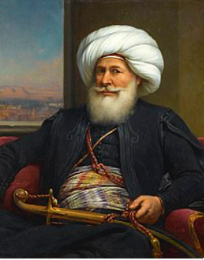
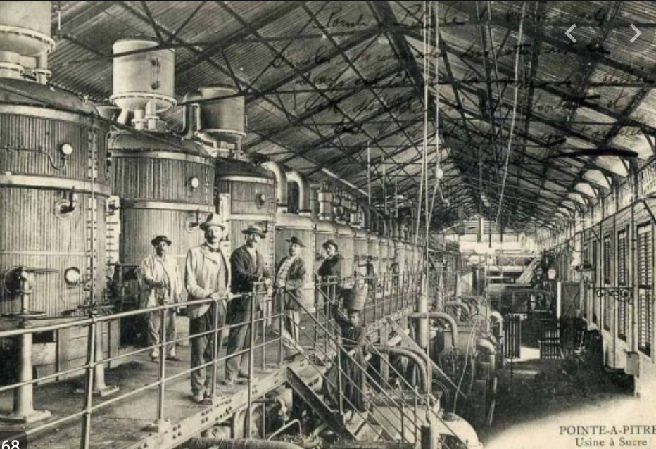
Egypt
Albanian Orphan Muhammed Ali (1769-1849):
Became effectively independent ruler of Egypt
(Still had prayers said in the mosques for the Ottoman Turkish sultan in Constantinople)
Strove to make Egypt great again
Cotton
Cotton textile factories
Sugar factories
Saw what was coming down
Feared that if Egypt did not industrialize, his grandchildren would be puppets of French bankers and British generals
Guess what?
3:45 of audio in this slide
Notes:
Muhammed Ali (1769-1849), an Albanian orphan, son of a shipping merchant Ibrahim Agha and his wife Zeynep, was bored being a tax collector in the Ottoman-ruled Greek port of Kavala. In 1801 he enlisted as a mercenary in the Ottoman army sent to occupy Egypt. By 1803 he commanded a regiment of his ethnically Albanian fellow-countrymen.
The Ottoman governor of Egypt could not afford to pay. He dismissed his Albanian troops. They mutinied, took over the government, and collected their pay. But Albanian commander Tahir Pasha then had no money to pay the Turkish janissaries.
Somehow Muhammed Ali wound up on top.
He retained the loyalty of his Albanians and managing to suppress both Turkish janissaries and Egyptain Mamluks. He then received at least the temporary blessing of Ottoman Sultan Selim III the Reformer (before he was deposed, imprisoned, and murdered by his own janissaries).
Muhammed Ali looked northwest at Europe and east to India. He noted Egypt’s role as crossroads between Africa and Asia, and between the Atlantic-Mediterranean Sea and the Red Sea-Indian Ocean. He ruled a prosperous kingdom—but he saw that Europeans might do to his or his children’s kingdom what Europeans had done to prosperous kingdoms in India.
So Muhammed Ali strove to make Egypt great: new crops, land reform, a modern military, a focus on cotton as an export, and the construction of state-owned textile factories to jump-start Egyptian industry. He understood that unless he could keep the machines working, his great-grandchildren would become the puppets of French bankers and British proconsuls.
But in Egypt in the first half of the 1800s, the machines could not be kept working.
In 1863, six years before the completion of the Suez Canal, the relatively young Khedive Ismail took the throne of Egypt.
Ismail had been educated in France: he was open to European influences, eager to modernize his country, and eager to play the role of the open-handed Eastern ruler. He became ruler of Egypt in 1863, in the middle of the "cotton famine" created by the American Civil War and the consequent temporary disappearance of the U.S. South from the world's cotton supply. The consequence was a cotton boom everywhere else in the world: the factories of the industrial revolution needed cotton to run on, and they were willing to pay almost any price for it. Egypt grew cotton. And so for a few years it seemed as though Egypt's economic resources and wealth were growing rapidly and were inexhaustible.
In 1876 the Egyptian government declared bankruptcy. The creditors of the Khedive became the rulers of the country. Ismail abdicated. Two financial controllers—one British, one French—were appointed with substantial control over taxes and expenditures. Their task was to make sure that Egypt was governed by Ismail's son to keep up revenue and pay off the debt. The Egyptians wondered why they were being highly-taxed to pay off debts run up by their extravagant ex-Khedive. British troops restored order in 1882. Thereafter the Khedive was a British puppet: the strategic importance of the Suez Canal for communications with India meant that British troops were to stay in Egypt on varying pretexts and for various reasons until 1956.
Muhammed Ali’s great-grandchildren were indeed the puppets of French bankers and British proconsuls

Slide 10
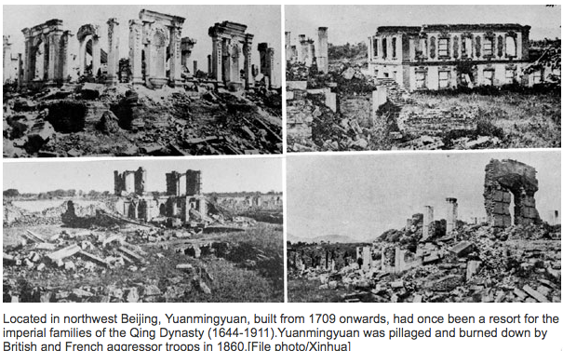
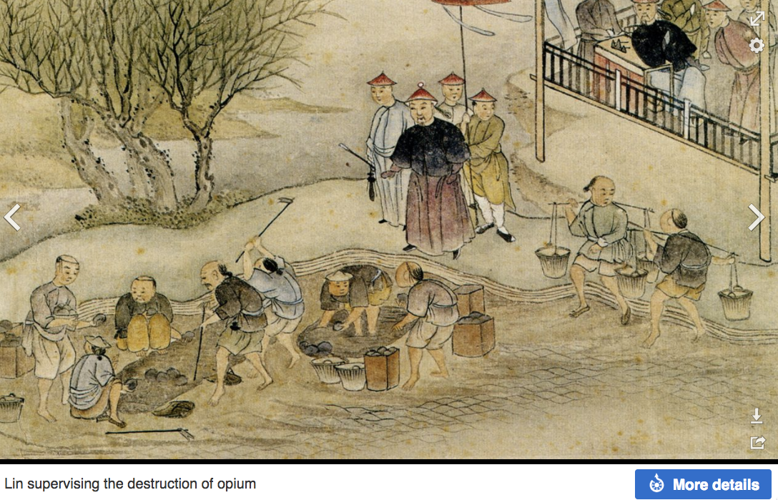
China
The puzzle of China vs. Japan
Great Qing (大清)(1644-1912)
Wu Sangui (吳三桂)
The Rebellion of the Three Feudatories (三藩之亂)
Kangxi and Qianlong: “revere the emperor and expel the barbarians” is difficult to pursue when the emperor and his clan identify themselves as “barbarians”
Tai-Ping Rebellion (太平天國運動)
Cixi ( 慈禧太后)
2:30 of audio in this slide
Notes:
Japan began, even before 1870, to strengthen itself and industrialize its economy. China did not. The century 1870-1975 marks China’s relative nadir in world history.
Why?
One factor: The ethnically Manchu Qing Dynasty could not rally the country behind a slogan like “revere the emperor and resist the foreign barbarians” because the emperor and his relatives identified themselves as foreigners. Moreover, they were regarded by the Han elite as barbarians.
Over more than two centuries of rule the Qing government of China had trained its Confucian landlord-bureaucrat-scholar aristocracy to be incapable of taking effective action. Effective action might be directed against the Central Government Security Perimeter (which is, perhaps, how we ought to translate what was back then translated as “Forbidden City”).
Many western China specialists see and can almost touch an alternative history—one in which late-nineteenth century China stood up economically, politically, and organizationally. Japan, after all, won its short victorious war against Russia in 1905, negotiated as an equal with Britain and the U.S. over warship construction in 1921, was perhaps the eighth industrial power in the world by 1929, and in 1942 Japan’s six fleet-carrier striking force, kido butai, was the most powerful, most feared, most technologically advanced, and most deadly military force on the world’s oceans.
We economists are much more skeptical. We note that while things like the Qing Imperial Maritime Customs Service built up in the 1860s under Robert Hart, Hart allowed no Chinese officials in it, primarily because he feared he would be unable to control their corruption, given the powerful protectors in the Qing imperial court such officials would acquire. We note the corrupt and incompetent bureaucracies that failed to manage the Yellow River dikes and the Grand Canal. We note that the Qing could not get their local officials to collect the salt tax. We note that when in the mid-1880s the Qing Dynasty, having bought foreign metal-working machinery and built a navy, arsenals, and docks, thought it was strong enough to oppose the French conquest of Vietnam, its fleet was destroyed in an hour: the Chinese navy lost 572 dead, while the French lost five. In 1895 the Qing Dynasty thought it was strong enough to oppose the Japanese extension of their sphere of influence to Korea. It was wrong. The Treaty of Shimonoseki added Taiwan, Korea, and southern Manchuria to Japan's sphere of influence.

Slide 11
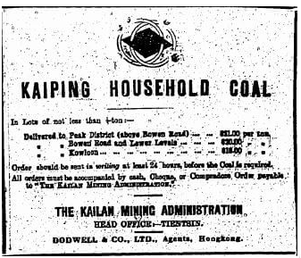
The Kaiping Coal Mine
Li Hongzhang (李鴻章) and the Kai-Ping coal mine…
From 1881…
Build up an industrial base…
Opposition…
Chang Yen-Mao
Bannerman
“Boxers” (义和拳)
Herbert Hoover
Chang Yen-Mao vs. Moreing…
Li Hongzhang (李鴻章) “did not have the reputation for financial disinterest enjoyed by his patron Zeng Guofan (曾国藩)”
3:00 of audio in this slide
Notes:
Why did not China have a chance of standing up in the later 1800s?
Let’s go back to the Kaiping coal mine, that we saw before as the source of Herbert Hoover’s first fortune.
Li Hongzhang was the bureaucratic prime mover behind that and such other “self-strengthening efforts” as the 1878 cotton mills in Shanghai, the Tianjin arsenal, the telegraph between Tianjin and Peking, and more. Individual governors-general like Li Hongzhang who made economic development a top priority could make some things happen—elsewhere things did not happen, outside of the foreign concessions and treaty ports like Qingdao, Tientsin, Shanghai, Guangdong, and Hong Kong.
In 1877 he commissioned experienced, wealthy, Hong Kong treaty-port comprador-merchant Tang Tingshu to build a modern, industrial, large-scale coal mine in Kaiping. They faced unusual forms of opposition. A British telegraph cable of 1882 stating that mining work had been stopped because Chi Shihchang, a vice-president of the Board of Civil Offices, had declared that:
>mining methods angered the earth dragon... [and so] the late empress could not rest quietly in her grave…
Li Hongzhang was this given the choice between abandoning his project for a modern coal mine to fuel steam engines, or accepting blame for any death or disease that might strike the imperial family. Given the size of the imperial family and mortality in the late nineteenth century, it would be a brave bureaucrat indeed who certified that there was no geomantic danger to the grave of the late empress from the earth dragon.
Li Hongzhang was brave.
Production began in 1881. By 1889, 3000 workers in three shifts were producing 700 tons of coal a day, using steam lifts, underground coal cars on rails, and pneumatic drills. By 1900, 9000 workers were producing 2000 tons a coal a day, with average pay 6 per month and with at least some Chinese-born technical employees making 60. The miners were producing 1/4 of what was expected of miners in America or Australia.
But the rate of production was still only six pounds a year for every person in China. And there was still no railway to Tientsin. In 1888 a railway had been built down to Taku, but Chief Engineer Claude Kinder reported: “high officials who detested the railway... foster[ed] trouble with the junk people.... So great was the clamor... that the Viceroy... gave the order for the nearly completed bridge [over the Peiho River to Tientsin] to be destroyed, although hundreds of the largest junks had already safely passed through…”
Then Herbert Hoover came.

Slide 12
Failure of “Self-Strengthening”
Kaiping: what had been a strategic initiative of the Chinese government becomes a western-owned corporation uninterested in training Chinese engineers…
But even before: the promotion of Chang Yenmao—a political fixer—meant that, unlike in Japan, economic strengthening was not job #1
Sun Yatsen offered his services to Li Hongzhang in 1894
Li sent him away
Yuan Shihkai came to the conclusion that working with the Manchu court was useless
China descended into revolution and anarchy…
2:00 of audio in this slide
Notes:
The upshot was that what Li Hongzhang and his successor in the Qing government Yuan Shihkai had thought was a strategic imperial government enterprise was now the property of a British-Belgian investors’ syndicate, with no interest in building China’s engineering capacity or supporting its foreign policy strategy.
A social-economic structure that could not find and promote executives but instead replaced them with corrupt political fixers, a political-ritual culture that required that a modernizing governor focus his attention constantly on the enterprise and run interference to protect it from anti-modernizers, and an educational system that continued to turn out literati instead of engineers—and thus required foreign technical personnel for everything—outside the charmed circles created by the extraterritorial foreign concessions, and to a slight degree the immediate span of control of the few modernizing governors, modern industries did not develop and modern technologies were simply not applied in late imperial China.
Visionary reforming politician Sun Yatsen had offered his services to Li Hongzhang in 1894, but Li sent him away. Sun Yatsen built up a financial and propaganda network among Chinese emigrants beyond the reach of the government.
Military politicians like Yuan Shihkai came to the conclusion that working with the Manchu court was useless.
At the beginning of 1912 Sun Yatsen launched his rebellion, and the Qing dynasty fell. Yuan Shihkai and his peers refused to suppress the rebellion, and thought their chances would be better without the Manchu Dynasty.
The six-year-old emperor abdicated. The new Chinese republic’s president turned out to be not Sun Yatsen military politician Yuan Shihkai. But Yuan Shihkai’s authority over his peers and near peers—army commanders, provincial governors, and other would-be warlords—was nil.
China descended into near-anarchy

Slide 13
We Could Tell More Stories
2:00 of audio in this slide
Notes:
We could tell many, many, many more stories of Europe’s late-1800s empires and how the colonized and the nearly-colonized tried to respond. But we have no space. So leave it there, with three: One was formally annexed, with Queen Victory of the Hanoverian Dynasty taking the title Kaiser-i-Hind—“Caesar of India”. (A title laid down only in 1947, to my knowledge the last time in history a ruler has called him or herself a “Caesar”. The historical shadow of the Divine Julius was indeed long.) One was informally annexed, with a strong British garrison. And one was always under the hammer of European and Japanese threat.
In all three the coming of imperialism and the market it brought Terry with a very cheap manufactured goods that the colonized could buy. And it carried with it infrastructure so that colonial proconsuls could communicate and travel back-and-forth to the metropole, and foreign industrialists and merchants could sell their products to captive colonial customers. But the educational systems and the engineering communities and the channeling of the savings of the masses into nascent industrial enterprises simply did not happen anywhere there was colonialism.
It did happen in Japan, and we will look at how it happened in Japan toward the end of the course.
But Karl Marx was wrong. Imperialism was not the handmaiden in support of industrial economic development in the global south. Agriculture and mining development, yes. But plantation and resource wealth turned out to be a development trap, albeit a comfortable trap for those who owned the plantations and the mines.

Slide 14
Formal Empires
There were, broadly, three views as to why European late-1800s empires rose to such domination, each of which with its own view of what was to be done to fix the situation:
One view is that of John Hobson: The major economic problem was the business cycle. Equipping the military needed to maintain the empire puts people to work. And an empire is a good source of consumers for the products of domestic factories. European governments that pursued empire, Hobson thought, were less likely to face economic distress and so more likely to continue in office.
A second view was that of Joseph Schumpeter: imperialism as the last gasp of military status aristocracy.
The third view was that empires were ordained by God—or at least morally required or desirable, for European powers had a civilizing mission. The Europeans were lucky enough to be the grownups, and it was the obligation of the grownups to civilize the world. But perhaps civilization is best spread by newspapers and books and merchants and engineers, rather than by alien proconsuls? Just a thought.
Notes:
Empires, formal and informal, both accelerated and retarded economic growth and development. But the business of empire was not economic development. The business of empire was… empire.
The conservative view was that empires were ordained by God—or at least morally required or desirable, for European powers had a civilizing mission. Let us give the mic to Rudyard Kipling:
Take up the White Man’s burden—
Send forth the best ye breed—
Go send your sons to exile
To serve your captives' need
To wait in heavy harness
On fluttered folk and wild—
Your new-caught, sullen peoples/
Half devil and half child…
In short: the Europeans were lucky enough to be the grownups, and it was the obligation of the grownups to civilize the world. Those being civilized might not like it: “sullen”, “captives”. Those being civilized were definitely not your equals: “half devil”, “half-child”, “fluttered”, “wild”. It was not a fun thing to do: “exile”, “heavy harness”. But still, for some reason, you needed to do it.
But perhaps civilization is best spread by newspapers and books and merchants and engineers, rather than by alien proconsuls? Just a thought.
The enlightened liberal belief in the early 1900s was that this made little sense, The enlightened liberal belief was that the then-existing empires were little but confidence games, and on their last legs.
Austrian economist Joseph Schumpeter thought the people were being conned—diverted to cheering for victories so that they do not notice that the landlord-aristocratic political-deference power structure makes no rational sense. Joseph Schumpeter thought the landlord-aristocrats were being conned too: sent to die of dysentery, wound-caused infection, or shot and shell when they could, instead, be happily drinking cappucinos with whipped cream at the Cafe Central at Herrengasse 14 in Vienna.
Imperialism was thus the last gasp of military status aristocracy. Sir Whatsit and Lord Whoever and Colonel Whichway were like today's professional athletes. Empire served as the equivalent of a sports team, winning victories—as in the immense Mafeking Night party in Britain when good news about the progress of British arms in the South African Boer War arrived. The military aristocracy loved to play, and the people loved to watch.
Schumpeter hated this. And he thought that it was on the way out—that as people became richer and more prosperous, the bourgeois virtues would win out, and the drive for empire will die. Schumpeter expected the con to end, and a peaceful, less aristocratic, less imperial, less bloodthirsty twentieth century.
He was wrong.
British activist John Hobson thought it was a con. He thought that having the government spend money and spend it putting people to work building weapons and then using the weapons to conquer colonies that could be forced to buy exports was a greatly suboptimal way of avoiding mass unemployment.
Hobson saw empire not as an attempt to plunder but as an attempt to sell, and also to produce. Hobson saw the major economic problem as the business cycle, caused by the maldistribution of income, that causes mass unemployment. A government needs to keep its people working and prosperous and happy. In this empire serves two goals: Equipping the military needed to maintain the empire puts people to work. And an empire is a good source of consumers for the products of domestic factories. European governments that pursued empire, Hobson thought, were less likely to face economic distress and so more likely to continue in office. The solution to empire, Hobson thought, would be more equality at home: then there would be smaller business cycles, less unemployment, and no need for empire.
And, Hobson thought, a pro-democratic pro-equality political shift was coming, and in its aftermath war and empire would lose their purpose. So he too expected a peaceful, more egalitarian, more democratic, less imperial, less bloodthirsty twentieth century.
He too was wrong.
British public intellectual Norman Angell thought that empire and war—except perhaps for wars of national liberation to give peoples self-government—were already completely pointless and obsolete. The idea that war could be in any sense rational or that there would be major twentieth-century wars was a Great Illusion. And surely governments could not be so inept or so shortsighted not to realize that, could they?
He too was wrong.
The same forces that propelled European powers to empire would also propel them to destructive industrial war, and in 1914 turn Europe into truly a dark continent. For the history of the long 20th century took a very sharp turn—a turn that appeared to negate all the progress in world civilization since 1870 and before and all the hopes built open them, with the start of World War I in 1914.

Slide 15
Lecture: 3.3.3. Informal Empires
But even where Britain (or France, or Germany, or Portugal, or Spain, or those who thought of themselves as descended from the conquistadores of Castile, or Anglo-Saxon settlers) did not rule, they reigned:
Britain seemed successful: playing by Britain’s rules seemed wise…
Britain was powerful: playing by Britain’s rules seemed likely to keep it from getting annoyed…
Britain was working very hard to make itself attractive—to make becoming a Briton-by-proxy of some sort straightforward and profitable in both money and cultural terms…
Britain was the first-mover hegemon: international cooperation was on its terms…
1:45 of audio in this slide & 6:30 in this group
Notes:
The power gradient that generated the likelihood and ever-present threat of formal empires, and the wealth gradient from the centralized location of modern industry in the North Atlantic, meant that the start of the long 20th century would see a world in which those who were not formally colonized would nevertheless be dominated by informal empire—overwhelmingly a British informal empire.
Again and again, others would find themselves in situations in which offers were being made to them that could not, realistically and prudently, be refused: under “hegemony”.
Perhaps the offers could not be refused because the consequences of accepting them are so good.
Perhaps the offers could not be refused because the consequences of not accepting them are so bad.
Perhaps the bad consequences would be military, or political, or economic. Perhaps the bad consequences would simply be exclusion. As mid-1900s socialist economist Joan Robinson liked to say, the only thing worse than being exploited by the capitalists was not being exploited by the capitalists—being ignored, and placed outside the circuits of production and exchange.
Plus there is the question of: consequences for whom? For a ruling elite, for the country’s current citizens, or for its current citizens’ descendants?
The hegemony exercised by the informal mode of the British Empire—and to a lesser extent of other European empires—in the first decades of the Long Twentieth Century had four important aspects: free trade, concentrated industry, free migration, and freedom of investment. These were the offers made that those outside of western Europe could not refuse.

Slide 16
Four Aspects of Pre-1914 Informal Empire
Playing by the rules of the game that Britain-as-hegemon imposed—made it dangerous to deviate from—had powerful consequences for how your economy and the world economy worked:
Free trade…
The concentration of manufacturing in the global north…
Free migration…
Freedom of investment
4:15 of audio in this slide\
Notes:
The first aspect was globalization and free trade: the coming of the steamship and the railroad—and of the European gunboat and maxim gun that, if you were a peripheral economy, would make your trade free through threat or conquest will-you, nill-you.
Steam-driven machinery provided a competitive advantage that handicrafts could not match, no matter how low were wages. And—Japan and isolated pockets of India apart—steam-driven machinery worked reliably only in the Global North. Thus manufacturing declined outside the industrial core, peripheral labor was shifted into agriculture and other primary products. And so the global periphery was “underdeveloped”: gaining in the short run from advantageous terms of trade, but unable to build communities of engineering practice that might provide a path to greater, industrial riches.
Second was, as noted, that the steam-driven machinery worked reliably and profitably only in the Global North. The “reliably” part required three things: a community of engineering practice, a literate labor force that could be trained up to use industrial technology, and sufficient economic depth to provide the maintenance, repair, and support services. As Robert Allen writes: “Industrial technology, however, was not cost-effective… [even though] wages were lower…. Asian producers either had to hope that the British would improve spinning machines sufficiently to make them cost-effective in Asia (which eventually did happen) or redesign the machines to adapt them to their own circumstances (which is what Japan did)…. [Moreover], widespread literacy and numeracy have been necessary (if not sufficient) conditions for economic success…”
Third was, as noted, the largely-free migration (save for Asians seeking to migrate to temperate zone economies) pattern of the early years of the long twentieth century.
Free trade, free capital flows, and free migration made possible by Europe’s informal imperial domination helped greatly enrich the world in the generations before World War I.
The fourth was freedom of investment. You could lend to whoever you wished. You could borrow from whoever you wished. But, before World War I, it was understood that you would at least try to pay it back. Certainly those economies that received inflows of capital before World War I benefitted enormously if they had the human, the skill, the capital, and the organizational resources to take advantage of them. For the U.S., Canada, Australia, for Argentina, and perhaps for others like India, the availability of large amounts of capital—largely British-financed capital—to speed development of industry and infrastructure was a godsend. It allowed for earlier construction of railroads and other infrastructure. It allowed for the more rapid development of industry.
It is not so clear that the free flow of capital was beneficial to those in the capital-exporting countries. France subsidized the pre-World War I industrialization of Czarist Russia (and the pre-World War I luxury of the court and expansion of the military) by making investments in Russian government and railroad bonds a test of one's French patriotism. A constant of French pre-World War I politics was that someday there would be another war with Germany, during which France would conquer and re- annex the provinces of Alsace and Lorraine that Germany had annexed as part of the settlement of the Franco-Prussian War of 1870-71. (And that France had taken from the feeble and oddly-named Holy Roman Empire of the German Nation as part of the settlements of the Thirty Years' War of 1618-48 and the Wars of Louis XIV of 1667-1715.)
French military strategy depended on a large, active, allied Russian army in Poland threatening Berlin and forcing Germany to divide its armies while the French marched to the Rhine. Hence boosting the power of the Czar by buying Russian bonds became a test of French patriotism.
But after World War I there was no Czar ruling from Moscow. There was Lenin ruling from Petrograd—subsequently renamed Leningrad—subsequently returned to its original name of St. Petersburg. And Lenin had no interest at all in repaying creditors from whom money had been borrowed by the Czar.

Slide 17
Emulation
And even where policies were not constrained, the fact that Britain was so successful made others want to be like Britain:
Why do the Japanese today wear British business suits?
Previous powerful nations had exerted a very strong cultural and even institutional influence over everyplace that could see and envy their success…
Late Victorian Britain was no exception…
The difference was that its reach was not confined to one subcontinent or continent, but extended across the entire globe…
0:30 of audio in this slide
Notes:
In addition to setting out the framework within which other countries’ governments and economies had to operate, there was one additional important facet of informal empire: the western Europeans—above all Britain—provided to the rest of the world an example to emulate. British institutions and practices appeared to be—had been—stunningly successful. Whatever they had done was worth emulating, at least on a trial basis, whether it was wearing business suits and dressing for dinner, translating Latin verse in school, establishing strong property rights, or investing in railroads and ports.

Slide 18
Lecture: 3.3.4. Empire, Migration, & the Development of Underdevelopment
1:15 of audio in this slide; 12:30 in this slide group
Notes:
The production and trade globalization of the late 1800s was fueled by 100 million people leaving their continent of origin to live and work elsewhere.
50 million left settled areas of Europe, mainly to the Americas and Australasia, but also to South Africa, the highland of Kenya, the black-earth western regions of the Pontic-Caspian steppe, and elsewhere. The redwood forests of northern California contain shrines to the boddhisatva Guan-Yin—although migration from China to European-settled California and to the rest of temperate-climate settler colonies and ex-colonies was quickly shut down. Plutocrats like Leland Stanford (the railroad baron and governor of California who founded and endowed Stanford University in memory of his son) favored immigration; the populists favored exclusion–and “Chinaman go home.”
50 million left from China and India to places from South Asia and Africa to the Caribbean and the highlands of Peru. Peru in the late twentieth century could have a President surnamed Fujimori. The author V.S. Naipaul was born not in India but in the Caribbean. Never before or since have we seen such a rapid proportional redistribution of humanity around the globe.

Slide 19
1870-1914 Migration Made for a Richer World
The two-thirds who migrated and stayed found their and their children’s living standards higher by a factor of between 1.5 and 3…
The one-third who migrated and then returned back home did so with resources that made them at the worst solid middle classes…
Wages in Europe rose…
Workers no longer faced competition from those who had left.
Resource-rich settlement areas like Canada and Argentina with Europe-like climates provided a further boost to the living standards of those who had been Europeans…
1:00 of audio in this slide
Notes:
1870-1914 migration made for a richer world: the one-third who migrated and then returned back home returned home, in most cases, with resources that made them at the worst solid members of their home economies’ middle classes. The two-thirds who migrated and stayed found their and their children’s living standards higher by a factor of between 1.5 and 3.
1870-1914 migration raised wages in Europe, as workers no longer faced competition for their jobs from those who had left. Europe was already escaping the Malthusian trap of low living standards and populations high relative to agricultural resources and technology. The availability of resource-rich settlement areas like Canada and Argentina with Europe-like climates provided a further boost to European living standards: industrializing European countries at the turn of the twentieth century found their land/labor and capital/labor ratios, and thus their productivity levels and living standards, rising as migrants left for America.

Slide 20
Immigration Restrictions
In the temperate zone economies to which migrants went, the populists won before World War I in one narrow aspect: with respect to making and keeping settler colonies “European”:
Asian immigrants were largely kept out of what Arthur Lewis calls the “temperate countries of European settlement”…
The flow of migrants out of China and India was directed elsewhere, to the tea plantations of Ceylon or the rubber plantations of Malaysia…
There is no sign that workers already on the labor-scarce western, peripheral side of the Atlantic lost out in any sense as a result of the migration wave from labor-abundant Europe…
Migration did not raise wages much in other migration-source economies…
China and India were so large relatively in population that emigration was a drop in the bucket…
Did migration lower relative wages in tropical-zone recipient economies?
Yes—and it did so in economies that never saw a migrant…
2:00 of audio in this slide
Notes:
In the temperate zone economies to which migrants went, the populists won before World War I in one narrow aspect: with respect to making and keeping settler colonies “European”. Asian immigrants were largely kept out of what Arthur Lewis calls the “temperate countries of European settlement”–the United States, Canada, Argentina, Chile, Uruguay, Australia, and New Zealand. The flow of migrants out of China and India was directed elsewhere, to the tea plantations of Ceylon or the rubber plantations of Malaysia.
There is no sign that workers already on the labor-scarce western, peripheral side of the Atlantic lost out in any sense as a result of the migration wave from labor-abundant Europe. American, Canadian, and Argentinian real urban worker wages appear to have grown at 1.0, 1.7, and 1.7 percent per year in the years leading up to 1914—compared to growth rates that averaged 0.9 percent per year in northwest Europe. Only in Australia, where real wages seemed to stagnate in the half-century before 1913, does increased trade appear to have played any role in eroding the relative wages of workers in a labor-scarce economy.
Migration did not raise wages much in other migration-source economies: China and India were so large relatively in population that emigration was a drop in the bucket.
Did migration lower relative wages in temperate-zone rich recipient economies? By little, if any: migration of people carried migration of capital with it, and mostly built out the scale of temperate-zone recipient economies.
Did migration lower relative wages in tropical-zone recipient economies? Yes—and it did so in economies that never saw a migrant. British capital, Brazilian-stock rubber plants, and labor imported from China to Malaya could and did put heavy downward pressure on the wages in Brazil of people who did not know there was such a place as Malaya.

Slide 21
Ecological Imperialism
Worth noting in all this is the role of the British Empire:
The comparative advantages of the regions that were to become the periphery of the late nineteenth century global economy were not so much given as made…
Where the British went they build a fort, some docks, and a botanical garden…
The botanical garden to discover what valuable plants grown elsewhere might flourish here as well.
During the nineteenth century:
the rubber plant came to Malaysia,
the tea shrub came to Ceylon, and
the coffee bush came to Brazil.
0:45 of audio in this slide
Notes:
Worth noting in all this is the role of the British Empire. The comparative advantages of the regions that were to become the periphery of the late nineteenth century global economy were not so much given as made.
Where the British went they build a fort, some docks, and a botanical garden—the botanical garden to discover what valuable plants grown elsewhere might flourish here as well. During the nineteenth century the rubber plant came to Malaysia, the tea shrub came to Ceylon, and the coffee bush came to Brazil. Rubber was not introduced into Malaysia, Indonesia, and Indochina until the last quarter of the nineteenth century. But by the end of World War I these three regions had become the principal sources of the world’s natural rubber supply.

Slide 22
Malthus’s Last Gasp
India and China, through ill-luck and bad government, had not escaped the Malthusian regime:
The population of China in the late nineteenth century was some three times what it had been at the start of the second millennium,
Living standards were no (or not much) lower.
But improvements in productive potential had been absorbed in rising populations
Thus the large populations and low levels of material wealth and agricultural productivity in China and India checked the growth of wages in any of the areas–Malaysia, Indonesia, the Caribbean, or east Africa–open to the Asian migration stream.
And as wages in economies that were to become the global periphery were checked, the prospects for having a rich-enough middle class to provide demand for a strong domestic industrial sector ebbed rapidly.
The world was now an integrated economic unit with a sharp Ricardian division of international labor: “tropical” regions and “temperate” regions
With the temperate regions increasingly manufacturing regions
2:45 of audio in this slide
Notes:
India and China, through ill-luck and bad government, had not escaped the Malthusian regime. Technology had advanced: the population of China in the late nineteenth century was some three times what it had been at the start of the second millennium, and living standards were no (or not much) lower. But improvements in productive potential had been absorbed in rising populations, and not in rising living standards. So potential migrants from China and India were willing to move for what seemed to Europeans to be starvation wages.
Thus the large populations and low levels of material wealth and agricultural productivity in China and India checked the growth of wages in any of the areas–Malaysia, Indonesia, the Caribbean, or east Africa–open to the Asian migration stream. Workers could be cheaply imported and employed at wages not that far above the physical subsistence level. These workers would be very happy with their jobs: their opportunities and living standards in Malaysian or African plantations would be significantly above what they could expect if they returned to India or China. Low wage costs meant that commodities produced in countries open to Asian immigration were relatively cheap. And competition from the Malaysian rubber plantations checked growth and even pushed down wages in the Brazilian rubber plantations as well. The late nineteenth century saw living standards and wage rates become and remain relatively low (although higher than in China and India) throughout the regions that were to come to be called the third world.
And as wages in economies that were to become the global periphery were checked, the prospects for having a rich-enough middle class to provide demand for a strong domestic industrial sector ebbed rapidly.
The world was now an integrated economic unit. Thereafter global economic development or its absence would, for the first time, be one story. One aspect of that global story was the emergence of a sharp Ricardian division of international labor: “tropical” regions supplied rubber, coffee, sugar, vegetable oil, cotton, and other relatively low-value agricultural products to Europe. Temperate-zone regions of expanding European settlement—the United States, Canada, Australia, New Zealand, Argentina, Chile, Uruguay, the Ukraine, and perhaps South Africa—produced and shipped staple grains, meats, and wool to Europe. German farmers found themselves with new competitors, and not just from the Americas: as much came in the form of Russian grain shipped from Odessa. Western Europe (and also the United States Northeast: industrial supplies and materials would rise to be fully half of U.S. exports by 1910) paid for its imports by exporting manufactured goods.

Slide 23
Why Not Balanced Industrialization?
Why didn’t industrialization spread more rapidly?
Keeping the machines working had been unachievable in the first quarter of the nineteenth century, in spite of all of the first Khedive of Egypt Muhammed Ali could do…
But by the end of the 1800s there were textile factories in Mumbai, Calcutta, Shanghai, Capetown, and Tokyo as well as in Manchester and Brussels.
As Arthur Lewis put it, the net effect of the coming of a single economic world was to enable a great many countries and regions to jump on the “escalator, taking countries to ever higher levels of output per head.”
Yet Lewis judges only six countries fully on the escalator of modern economic growth as of 1870.
Why didn’t industrialization did not spread much more rapidly to the future third world in the years before World War I?
If Ford could—as it did—redesign production so that unskilled assembly line workers do what skilled craftsmen used to do, why couldn’t Ford also—or someone else—redesign production so that it can be carried out by low wage Peruvians or Poles or Kenyans rather than by Americans, who even by 1914 were extraordinarily expensive labor by world standards?
Political risks? The advantages to being near your machine suppliers and near other factories making similar products? The need to have specialists close at hand to fix the many things that can go wrong? We understand far too little…
“Peripheral” economies did a superb job at specializing in plantation agriculture for export.
They did a bad job at creating modern manufacturing industries that could have also turned their low relative wages into a durable source of comparative advantage.
It remains a puzzle…
4:45 of audio in this slide
Notes:
With the greatly increased speed of transmitting information, the greatly lowered cost of transporting people and the knowledge inside their heads, and the greatly lowered cost of transporting machines and the knowledge embodied in them, it seems as though, for the first time in history, it ought to have been possible to apply any productive technology known to humanity in any corner of the world.
Keeping the machines working had been unachievable in the first quarter of the nineteenth century, when all of the first Khedive of Egypt Muhammed Ali’s desire and will to turn Egypt into a center of textile manufacture so that his grandchildren would not be the puppets of French bankers and British proconsuls. His textile factories stopped working. And his grandson the Khedive Ismail indeed became the puppet of French bankers and British proconsuls.
But by the end of the 1800s that possibility seemed within reach.
Then there were textile factories in Mumbai, Calcutta, Shanghai, Capetown, and Tokyo, as well as in Manchester and Brussels. The core committed resources—capital, skilled and unskilled labor, organization, and demand, the last through its need for and willingness to buy peripheral products. Before 1870 Western Europe’s staple imports were limited to cotton, tobacco, sugar, and wool—with a little palm oil, furs, hides, tea, and coffee as well: luxuries, not necessities or even conveniences. After 1870 technology demanded oil for diesel and gasoline engines, nitrate fertilizers for fields, copper wiring, and rubber tires. And even without new technologies the much-richer post-1870 North Atlantic core’s demand for cocoa, tea, coffee, silk, jute, palm oil, and other tropical products skyrocketed. Commodity demand and industrial technology transfer ought to have seen the world start to draw together.
As Arthur Lewis put it, the net effect of the coming of a single economic world was to enable a great many countries and regions to jump on the “escalator, taking countries to ever higher levels of output per head.” Yet Lewis judges only six countries fully on the escalator of modern economic growth as of 1870.
It is understandable that China, India, and the other regions of what would become the post-World War II third world did not produce and export the relatively high-value commodities like wheat and wool exported by temperate settler economies: agricultural productivity was too low, and climate was unfavorable. It is understandable why–with heavy downward pressure put on wages in Malaysia, Kenya, and Colombia by migration and threatened migration from China and India–the prices of the export commodities that they did produce were and remained relatively low.
What is more puzzling is why industrialization did not spread much more rapidly to the future third world in the years before World War I. After all, the example of the industrial core seemed easy to follow. Inventing the technologies of the original industrial revolution–steam power, spinning mills, automatic looms, iron- and steel-making, and railroad-building–had required many independent strokes of genius. But copying the technologies did not, especially when you could buy and cheaply ship industrial capital goods made in the same New and Old England machine shops that supplied the industries of England and of America.
If Ford could redesign production so that unskilled assembly line workers do what skilled craftsmen used to do, why couldn’t Ford also—or someone else—redesign production so that it can be carried out by low wage Peruvians or Poles or Kenyans rather than by Americans, who even by 1914 were extraordinarily expensive labor by world standards?
Political risks? The advantages to being near your machine suppliers and near other factories making similar products? The need to have specialists close at hand to fix the many things that can go wrong? We understand far too little about why the pace of technological diffusion out of the industrial core was so slow back before World War I. “Peripheral” economies did a superb job at specializing in plantation agriculture for export. They did a bad job at creating modern manufacturing industries that could have also turned their low relative wages into a durable source of comparative advantage.
It remains a great puzzle to me. When my classes ask, I say that Britain’s (and then America’s, and then Germany’s) initial cost advantage was so huge that it would have required high tariffs indeed in order to nurture “infant industries” in manufacturing. I say that colonial rulers refused to let the colonized do so. I say that the ideological dominance of free trade kept many others from even considering that perhaps a Hamiltonian “developmental state” approach might benefit their economies in the long run.
But I do not claim to understand.

